Slide 1

Allergen Chip Challenge 3rd Place Solution
From Mithil Salunkhe

Slide 2

Contents
Data Processing
Finding the best model and hyperparameters
Post processing
Final Opinion

Slide 3

Data processing
Removing
Removing any row which contains the Label 9 from the Dataset
Splitting
Splitting the Data Frame into multiple folds using Multilabel stratified K-Folds from the iterative-stratification library for the purpose of cross validation
Filling
Filling the Nan Values present in dataset with means values of the respective columns
Notes:
Removal of the Label ‘9’ as it represents unlabeled patients . Inclusion of this label in the training process resulted in a decline of the F1 score , hence I decided not to include it in the training phase
Next, I split the dataset into multiple folds for cross-validation. I used the MultilabelStratifiedKFold approach from the iterative-stratification library. This method ensures that each fold is a good representative of the whole by maintaining the proportion of each label. This is a crucial step as this ensured that I had Stable Cross Validation and Public Leaderboard correlation . Because of this , I was able to gain places in the final shake up as I did not overfit to the dataset in the public leaderboard . Remember , Always trust you cross validation
Dealing with missing values is a common preprocessing step in machine learning. Initially, I experimented with different imputation strategies, such as replacing NaNs with zeros, taking the mean of the row or using advanced techniques like sklearn's IterativeImputer . IterativeImputer is a more sophisticated imputation transformer that models each feature with missing values as a function of other features, and uses that estimate for imputation. It iterates over each feature, using it as a target variable and the other features as predictors, in a round-robin fashion. However, these methods did not yield the best results. Ultimately in the end , the simple method of using the mean of each column was the best

Slide 4

Feature ENGINEERING
Opted for simple feature engineering through which resulted in the production of the following columns
row_mean – Average Value of each row across the metadata column
Mean_std = The standard deviation across the specified columns for each row, reflecting the spread of the data
mean_std_mul - The product of the row's mean and its standard deviation, giving a combined measure of central tendency and variability
Prod - This represents the product of all the values in each row.
row_sum – Sum of all the metadata in the row
Notes:
Simple Feature Engineering - Opted for simple feature engineering through which resulted in the production of the following columns
Today, I'll cover the feature engineering techniques that were key to enhancing our model's predictive power.
row_mean: I started by calculating the average value for each row across the metadata columns. This simple yet effective metric captures the central tendency of the data, providing a baseline around which other measures can be compared.
Mean_std: Then, I computed the standard deviation for specified columns in each row. This reflects the variability or spread of the data, giving us insight into how much the data points diverge from the average.
mean_std_mul: To merge the insights gained from the mean and standard deviation, I created a combined metric by taking their product
Prod: Additionally, the product of all values within each row was calculated. This represents the interaction between all features and highlights rows with exceptionally high or low overall feature values, which could be indicative of outlier or significant cases.
row_sum: Lastly, the sum of all metadata in each row was taken. This total sum can be particularly useful in algorithms that are sensitive to the scale of the data, acting as a proxy for the overall magnitude of the feature set for each instance.

Slide 5

Model
Yes ! Xgboost is truly all you need
Tried a lot of different gradient boosting methods and traditional ML methods such as Catboost , LightGBM , RandomForest . After evaluation XGBoost
Tried Ensembles , but I was not able to make it work. Because of this , I ended up relying on a 15-fold XGBoost model.
Employed `MultiOutputClassifier` from `sklearn.multioutput` to harness the power of XGBoost for predicting 29 binary target variables within a single framework, enabling efficient multi-label classification
Notes:
XGBoost (Extreme Gradient Boosting) is an advanced implementation of the gradient boosting algorithm, introduced by Tianqi Chen in 2016. XGBoost gained significant favor in the last few years because of helping individuals and teams win virtually every Kaggle structured data competition. Some key features of Xgboost Include
Regularized Gradient Boosting with both L1 and L2 regularization
Parallelization of tree construction to make full use of all the CPU cores during training
The Choice of using 15 Cross Validation folds was arrived through iteration over the number of folds , with the iteration range being from 5 folds to 25 folds. 15 Folds provided the best F1 score.
I was faced with the task of predicting multiple binary outcomes. To address this multi-label classification problem, I employ scikit-learn's `MultiOutputClassifier`. This enables me to enhance a single-output classifier, like XGBoost, to handle multiple targets with ease.
How does it achieve this? `MultiOutputClassifier` operates by constructing an individual classifier for each separate target. In our case, it creates 29 XGBoost classifiers since we have 29 targets. The process is as follows:
Training Phase For each target, the `MultiOutputClassifier` independently fits the specified base classifier (XGBoost here). It treats each target as a separate binary classification problem, which is useful for our dataset where each feature set might influence each target differently.
Prediction Mechanism: When making predictions, the meta-estimator invokes each individual classifier to predict its corresponding target. It’s a parallel process, where all classifiers operate on the input feature set to output their predictions.
The beauty of the `MultiOutputClassifier` is in its ability to manage this task while maintaining the interface of a single-output classifier. This allows for simpler code and a streamlined modeling process,

Slide 6

HYPERPARAMETERS
The Following Hyperparameters were tuned through trial and error for the xgboost model
Number of Estimators: Set to 950, representing the number of trees constructed during training, chosen to optimize the model complexity and generalization ability.
1
Learning Rate: Determined a learning rate of 0.06 after comprehensive trial and error to balance the speed of convergence with the risk of overshooting the minimum loss.
2
Colsample_bytree: Fixed at 0.5, indicating that each tree built during training would consider a random sample of 50% of the features, promoting model robustness and preventing overfitting.
Notes:
N_estimators - Number of Boosting Rounds: The term 'n_estimators' refers to the number of boosting rounds or decision trees used in the ensemble. Here, 950 trees mean that the model iteratively learns from the data 950 times, refining its predictions with each round. More trees can often lead to better performance, but also increase the risk of overfitting. Hence, selecting the right number requires balancing model complexity against the risk of memorizing the training data too closely.
Learning Rate: The learning rate controls how quickly the model adapts to the problem. With a rate of 0.06, our model makes moderate adjustments to the weights of features after each boosting round. This slower pace of learning ensures that the model doesn't miss the subtleties in the data by making too large adjustments, a common problem known as 'overshooting'. It's a crucial parameter that can greatly influence the convergence and final performance of the model.
Colsample_bytree - Feature Sampling: 'colsample_bytree' is our feature sampling hyperparameter, set at 0.5. This means that for each tree the model builds, it randomly selects half of the features to consider at each split. This technique helps in making the model more robust to noise and prevents it from relying too heavily on any single feature, which is especially important when dealing with datasets that have many features.

Slide 7
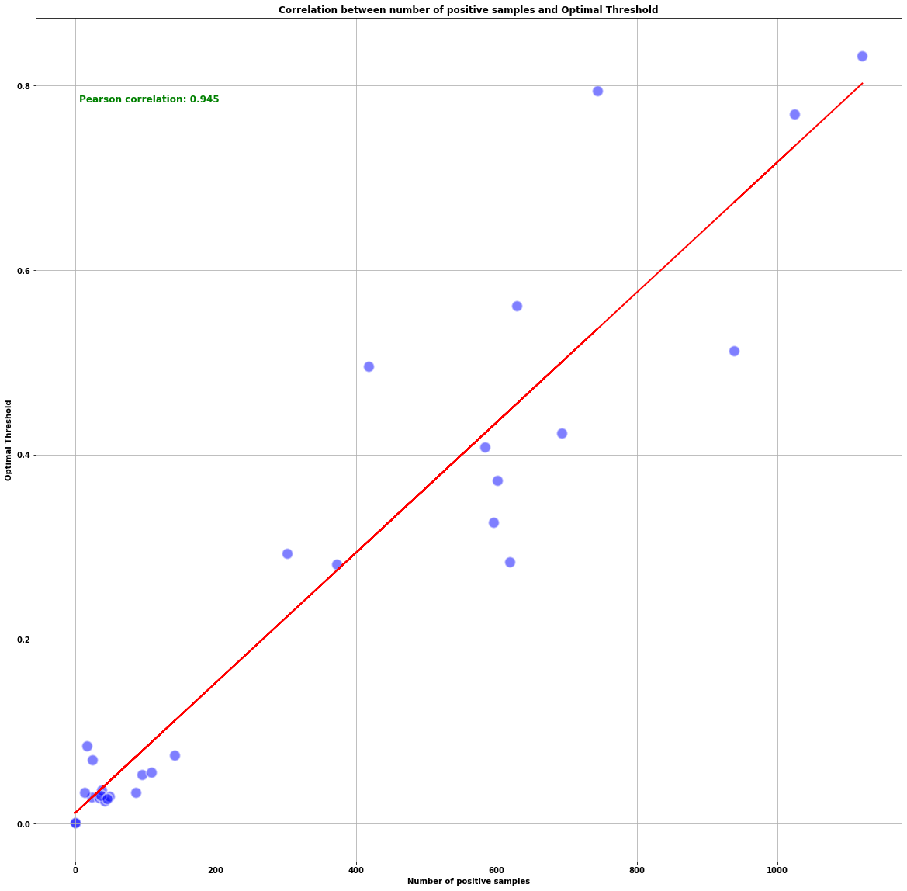
Post Processing
In binary classification for our 29 different targets, we have two classes, labeled as '0' and '1'.
A threshold is the probability cut-off we set to decide when to classify a prediction as '1' over '0'.
Threshold Range: Defined a range of potential thresholds from 0.00001 to 0.99999 to identify the best threshold for each target
Optimal Thresholds: Executed an iterative process to find the threshold that yields the highest macro F1 score for each target
Results:
Before setting threshold for each target: Average F1 score ≈ 0.5
After setting threshold for each target : Average F1 score ≈ 0.775
Interesting Observations - The scatter plot shows an interesting relationship: when the number of class 1 samples increases, we need a higher threshold for our classifier to achieve its best performance. The correlation between number of class 1 samples and these optimal thresholds is strong, at 0.943 Pearson correlation .
Notes:
The Most important Post processing that we do is setting a threshold
Understanding Thresholds: In a binary classification task for each of the 29 targets, we have two possible classes: 0 and 1. A threshold is a cut-off value that determines at what predicted probability we classify a sample as class 1 instead of class 0. For instance, if our threshold is 0.3 and our model's predicted probability for class 1 is 0.35, we would classify this sample as class 1 because the predicted probability exceeds the threshold.
Competition Metric Explanation: The macro F1 score is the competition metric. The macro-averaged F1 score (or macro F1 score) is computed using the arithmetic mean (aka unweighted mean) of all the per-class F1 scores. This method treats all classes equally
Threshold Range and Impact: We experiment with thresholds ranging from 0.00001 to 0.99999. The threshold essentially acts as a sensitivity setting. A lower threshold makes the classifier more sensitive to classifying samples as class 1, while a higher threshold requires more certainty in the prediction to classify a sample as class 1.
Optimal Thresholds: We use an iterative search to find the threshold that provides the highest macro F1 score, thus optimizing the balance between precision (the model's accuracy in predicting class 1) and recall (the model's ability to find all class 1 samples). The optimal threshold for each target is found where the F1 score is at its maximum.
Results and Improvement: By fine-tuning the threshold, we have significantly improved the model's performance in distinguishing between the classes:
Before threshold optimization: average macro F1 score ≈ 0.5.
After optimization: average macro F1 score ≈ 0.775.
Correlation Insights: The scatter plot presents a clear trend: as the number of positive samples (class 1) for a target increases, the optimal threshold also increases. The Pearson correlation coefficient of 0.943 confirms a strong positive correlation between these two variables

Slide 8
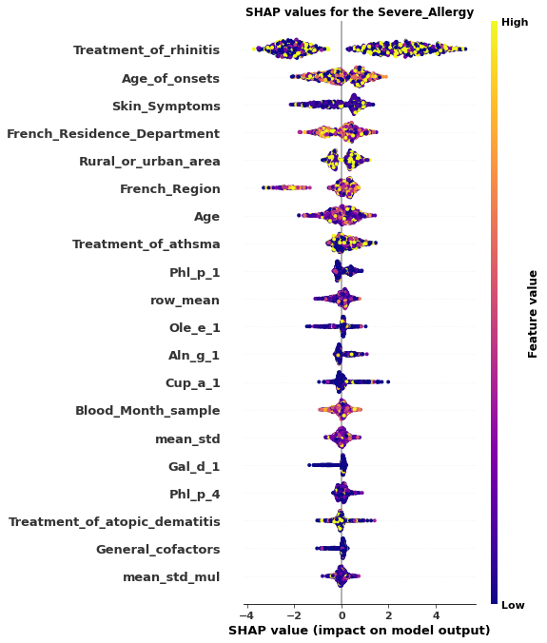
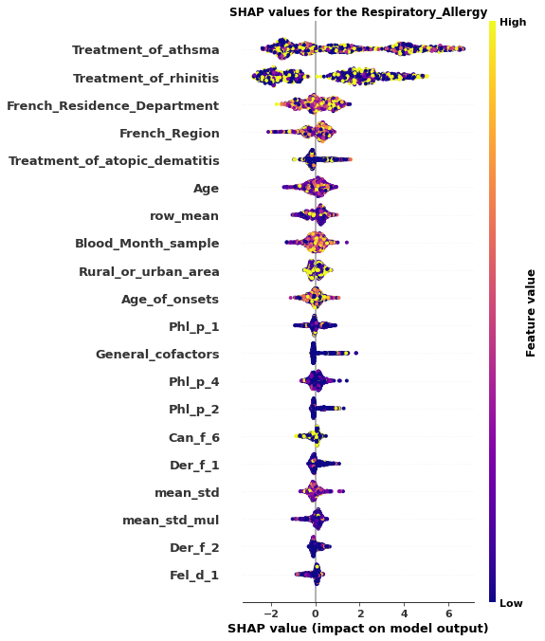
SHAP values
SHAP plots for all the targets can be found at 3rd place solution notebook at the GitHub repo - https://github.com/Trustii-team/AllergenChip
Notes:
What are SHAP (SHapley Additive exPlanations) Values?
Imagine you want to understand the prediction for a single data point ,
The SHAP value for each feature tells you how much that feature pushed the model's output higher or lower, compared to the average prediction for the dataset.
Calculation Process -
For each feature, the model's prediction is computed with and without that feature
The difference between the prediction with and without the feature is calculated for each combination.
These differences are then weighted and averaged to produce the SHAP value for that feature
Why are SHAP Values Important?
Machine learning models, especially complex ones like those built with XGBoost, can often feel like black boxes. SHAP values help in "opening" these boxes.
They allow us to see the impact of each feature on the model’s output, making the model more interpretable and transparent.
For 'Severe Allergy,' notice how 'Treatment_of_rhinitis' and 'Age_of_onsets' feature prominently, indicating their strong positive influence on predictions. Contrastingly, 'General_cofactors' show a lower impact, suggesting these aren't as critical in the model's decision-making process for this specific target.
Switching to 'Respiratory Allergy,' we observe a different hierarchy of feature importance, with 'Treatment_of_asthma' and 'Treatment_of_rhinitis' leading the way. This variation between targets is key to understanding the distinct factors that contribute to different allergy types.
I have plotted these SHAP values in my winning notebook ,

Slide 9
Wanted To DO but could not
Trying an ensemble of multiple seeds for XGBoost for additional robustness
Usage of images provided by the hosts
More Feature engineering
Notes:
Was Not able to try an ensemble of multiple XGBoost because I ran out of time for training models, since it took me around ~2 hours to train the models
I tried to use the images provided in the start , but because of poor results (the reason for this is likely because I ran only 2-3 experiments involving images. Only one CNN was tried for image which was resnet50) . If more resources such as GPUs would have been available for the participants, I think the winning solutions would have involved the usage of image data.
Since this is my 1st proper tabular competition , my feature engineering was basic. Given the skills I have learned from this competition , I feel that I would be able to better feature engineering in future competitions.

Slide 10
THANK YOU ! AND
Q&A
Notes:
And that is all my solution for the allergen Chip . I wish to express my sincerest thanks to the French Society of Allergology and the Health Data Hub for their pioneering work and for bringing us all together in the pursuit of advancing medicine and allergology. It has been an extraordinary journey exploring the intersection of artificial intelligence and allergology, and I am honored to have been a part of this pivotal project. I am profoundly thankful for the support of Trustti.io. I would also like to thank all the participants in the competitions who shared their valuable insights on the forum. I must extend a special word of appreciation to Julien Goret. Julien, your support was invaluable for me to able to present this today. Thank you once again for this honor and for the opportunity to contribute to a cause that touches so many lives

